Slide 1
IV. Diving into UAT BAU & Deliverables
Designed by “Learning Academy” – An AWM TCOE Initiative

Slide 2
Topics
Test planning & strategy – Outlining Test plan
Analyzing requirements – Designing Requirement Traceability Matrix
Test design – Designing Test cases, Review / Query log
Test execution & Defect reporting – Fabricating Daily Status Reports, Pass Logs & Defect Logs
Sign off

Slide 3
Test planning – Outlining Test plan
A test plan is a detailed document that outlines the test strategy, Testing objectives, resources (manpower, software, hardware) required for testing, test schedule.
Before UAT cycle starts, a Test plan is created to guide the entire UAT cycle

Slide 4
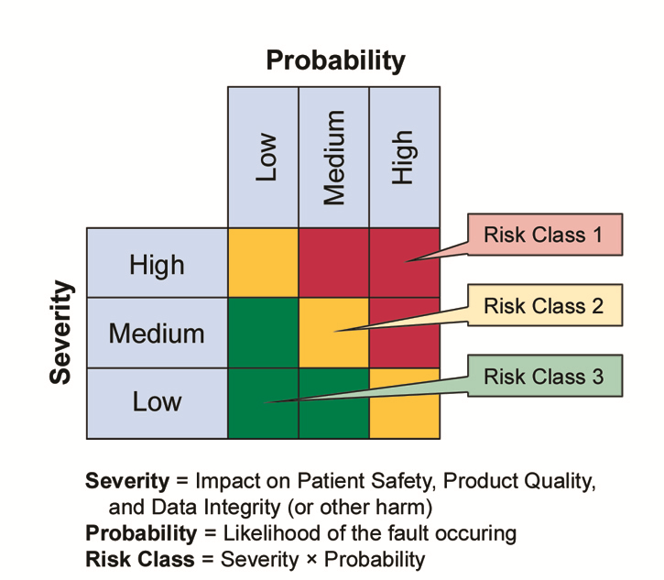
Test Strategy
Depending on the timelines and scope of Testing, a strategy is devised to cope up with the deadlines.
Priority / Risk based is one of the most prevalent used Test Strategy

Slide 5
Analyzing requirements
Requirements are shared either in a word document (known as Business Requirements Document) OR as user stories in JIRA tool.
Reading and understanding the thoroughly is required here.

Slide 6
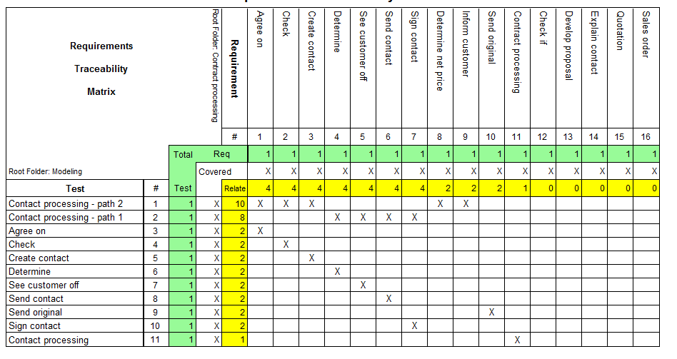
Requirements Traceability Matrix
Maps Requirements with respective Test cases.

Slide 7
Test Design
On the basis of requirements, Test cases are designed.
Test cases can be designed in an excel spreadsheet as agreed upon by stakeholders.
Test cases need to be reviewed and signed off by business before using them for Test execution.

Slide 8
Understanding a Test Case document

Slide 9
Review logs
As mentioned, Test cases need to be reviewed by business.
For this process, a predefined format of review logs are used as below:

Slide 10
Test Execution & Defect Reporting
Test cases designed are executed by comparing actual results with expected results.
Actual results are recorded in the Test case spreadsheet along with screenshots which are used as evidences. These screenshots are nothing but Pass Logs.

Slide 11
Defect Logs
Any discrepancy between actual and expected result is reported as a bug.
Bugs / defects are reported in JIRA or in the below format known as Defect log:

Slide 12
Daily Status Reports
In the entire Test execution cycle of UAT, a concise report needs to be sent out to all stakeholders at the end of each day’s execution.
This report captures test execution status, progress, challenges, RAG status, defect status and different metrics.

Slide 13
Sign off
Upon successful completion of Test execution, a sign-off email is sent out which states whether the system is good to be deployed into production.
It consist of summary of Test cases executed, Test cases passed, failed, Defects and their respective status, severity, etc.

Slide 14
Conclusion
In this session, we got insights on UAT phases and the corresponding key deliverables in each phase.
These deliverables & documentation are specific to the project and the SDLC model used.
The documents and its format changes accordingly as agreed upon by the stakeholders.

